Slide 1
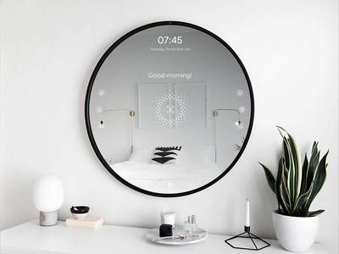
SMART MIRROR
AKSHAYA K R
ROLLNO:11

Slide 2
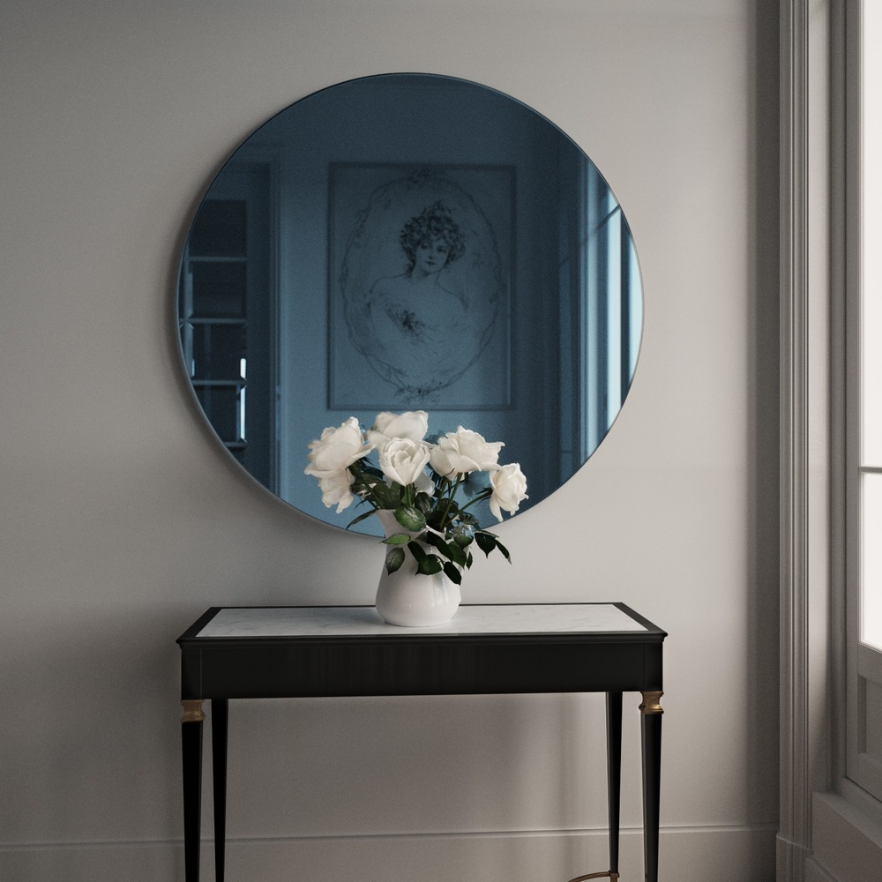
RELEVANCE
Smart Mirror is the technology that is introduced as a two-way mirror with an electronic display behind the glass as the world around us is constantly changing with the advancement of technologies . Smart Mirror is growing in popularity due to its interactive way in communicating user with technology. Living with the advancement of science and technology requires us to keep moving towards faster and easier life

Slide 3
DESCRIPTION
The smart mirror has been helpful people from various aspects which depends on the developer what are the objectives to be achieved as different kind of features can be included into the smart mirror. Nowadays, mirror will not only reveal whether you are the prettiest of them all. It will also inform about the time, date, weather, upcoming calendar appointment.

Slide 4
OBJECTIVE
To develop an smart mirror that can view the daily news and weather info using Python

Slide 5
EXISTING SYSTEM
A mirror is a reflective surface that bounces off light, producing either a real image or a virtual image.
When an object is placed in front of a mirror, the image of the same object is seen in the mirror.
It is used for viewing our appearance.

Slide 6
PROPOSED SYSTEM
Smart mirror also gives us,
News Reports
Clock
Weather Details,Temperature

Slide 7
MODULES

Slide 8
1)News API for daily news
Import necessory modules
Setting up API for news extraction
Setup python text to speech engine
Extract news from news api website using python
Read heading and content
Display on GUI

Slide 9
2)Weather API for temperature and weather info
Setting up weather api
Add current location
Extract weather data
Show result in GUI

Slide 10
METHODOLOGY
Smart Mirror As A Mirror
We can see our view as we can see it in a natural mirror while looking and grooming with the help of one way mirror with high concentration of aluminum content.
2.Smart Mirror As A Information System
Time, Date, weather details and news are fetched from online using predefined URL.

Slide 11
SETUP
External LCD monitor for display the process
Two way mirror(If required then readymade mirror is not available, so we need make the two way mirror from local glass making company)

Slide 12
UI & DESIGN
GUI will be desktop application

Slide 13
SPECIFICATIONS
Hardware Specification
Processor: i5
RAM: 8GB
Hard Disk
Mouse
Keyboard

Slide 14
Software Specification
Tool: Python
Python: version3
Operating System: Windows 7 or later

Slide 15
REFERENCES
[1] https://ieeexplore.ieee.org/document/9418408
[2]http://ijasret.com/VolumeArticles/FullTextPDF/394_5.IoT_BASED_SMART_MIRROR_USING_RASPBERRY_Pi_4.pdf
[3] S. Athira, F. Francis, R. Raphel, N. S. Sachin, S. Porinchu and S. Francis, "Smart mirror: A novel framework for interactive display," 2016 International Conference on Circuit, Power and Computing Technologies (ICCPCT), Nagercoil, 2016
[4] M. M. Yusri et al., "Smart mirror for smart life," 2017 6th ICT International Student Project Conference (ICT-ISPC), Skudai, 2017

Slide 16
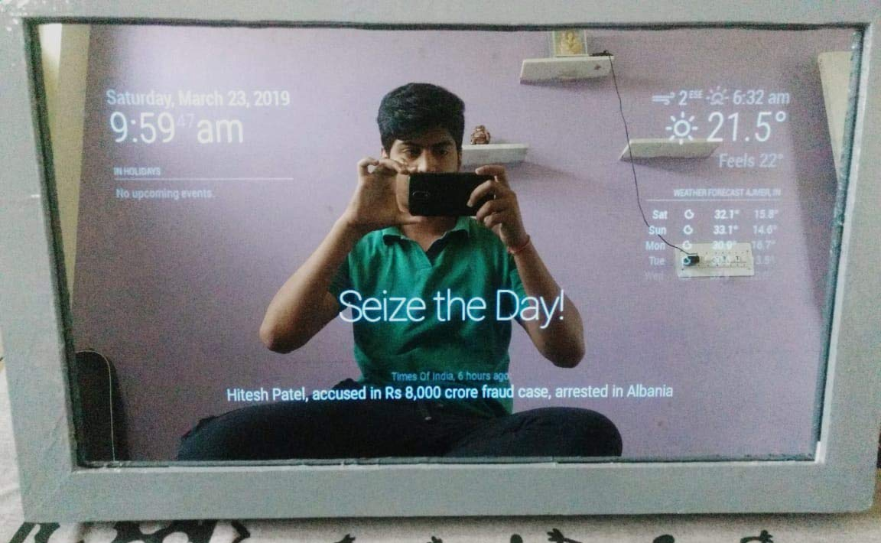
OUTPUT

Slide 17
THANK YOU

